Slide 1
ACTION!
Get Ready for the GA Milestones!
5th Grade
Social Studies Review
Elementary Elements ©2013

Slide 2
This review can be used in many ways! Use as morning work, homework, independent class work, partner work, total group review on Smartboard, small group review…Endless! Students can keep corrected/completed sheets to use as review at home. Best of luck to you and your 5th graders!
Thanks to 3am teacher for super cute “clapper board” frame.

Slide 3
Name___________
What book turned many Northerners against slavery?
A.) Night Travels
B.) Uncle Tom’s Cabin
C.) Virginia’s Story
D.) Emancipation Proclamation
In 1865, the Thirteenth Amendment was the first amendment added to the United States Constitution after the Civil War. Tell why this amendment was so important.
__________________________________________________________________________________________________________________________________________________________________________
Why was the Freedman’s Bureau created during The Reconstruction?
________________________________________________________________________________________________________________________________________________
How did Abraham Lincoln help to end slavery in the United States?
A.) Lincoln voted for Virginia to
be a separate country.
B.) Lincoln developed the
Underground Railroad.
C.) Lincoln wrote the
Emancipation Proclamation.
D.) Lincoln fought in the Battle of
Lexington.
An important poet by the name of _____________________________________,
wrote about African Americans during The Harlem Renaissance.
What did Alexander Graham Bell invent?___________

Slide 4
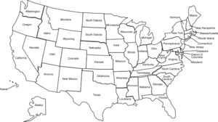
Which star on the map shows the location of The Battle of Gettysburg?
A.) A
B.) B
C.) C
D.) D
Name___________
A
B
D
C
Tell why President Harry S. Truman decided to use atomic bombs on the Japanese cities of
Hiroshima and Nagasaki:
_________________________________________________________________________________
Why were some American women nicknamed “Rosie the Riveter” during World War II?
____________________________________________________________________
Which of the following was one cause of The Great Depression?
A.) High oil prices
B.) Gold rush ending
C.) End of World War II
D.) Crash of The Stock Market
What made cars more affordable in the 1920’s?
A.) Low paid factory workers
B.) Increased demand for cars
C.) Stock Market increases
D.) Assembly line production
The Nineteenth Amendment gave women the right to __________.

Slide 5
Name___________
Which physical feature is located at the dot on the map?
A.) Mojave Desert
B.) Great Salt Lake
C.) Persian Gulf
D.) Salton Sea
Tell how the Mississippi River helped to promote economic activity in the United States:
_____________________________________________________________________________________________________________________________________________________________________
All of the following are freedoms granted and rights protected by the Bills of Rights EXCEPT which one?
A.) People have the right to
attend the church of their
choice
B.) People have the right to own
a weapon
C.) People can create their own
rights besides those stated
in the Constitution
D.) People have the right to a
public trial by a jury
Use the list below to answer this question.
The Dust Bowl
Falling prices
Banks failing
The New Deal
All of these are associated with the__________
A.) Great Migration
B.) Spanish-American War
C.) Civil War
D.) Great Depression

Slide 6
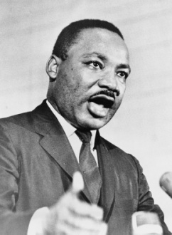
Name___________
I fought for civil rights. I gave a famous speech at our nation’s capital. Who am I? ________________
What was the Harlem Renaissance?
________________________________________________________________________________________________________________________________________________________________
Who was president when the Spanish-American war began?
A.) William McKinley
B.) Theodore Roosevelt
C.) Woodrow Wilson
D.) John F. Kennedy
The line dividing Eastern and Western Europe after World War II was known as the ________________.
How did Henry Ford help to change the automobile industry?
__________________________________________________________________________________________________________________________________________________________________
Which major sector in the U.S. economy is responsible for taxing and providing money towards education, health care, and other public services?
A.) the government
B.) the bank
C.) private businesses
D.) the household
At what point does an amendment become part of the Constitution?
A.) Once voters cast their votes
B.) Once it is ratified by ¾ of
the states
C.) Once the president presents
the amendment
D.) Once the amendment is
presented to Congress

Slide 7
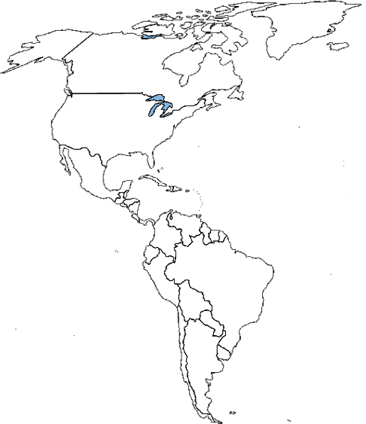
Name___________
What is located at the dot on the map?
A.) Panama
Canal
B.) Mississippi
Delta
C.) Suez Canal
D.) Lake Lanier
Which of the following was created by the river flow of the Colorado River?
A.) the Pony Express
B.) the Grand Canyon
C.) the Mojave Desert
D.) the Salton Sea
What is the United Nations and why was it formed?
__________________________________________________________________________________________________________________________________________________________________________
What did Thomas Edison invent?
_________________________
During World War I, what did Germany use to attack ships?
A.) nuclear weapons
B.) drones
C.) u-boats
D.) paratroopers
What was the New Deal? What did President Roosevelt hope it would do?
____________________________________________________________________________________________________________________________________

Slide 8
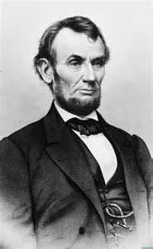
Name___________
After the Civil War, cotton and tobacco became important crops in the
A.) East
B.) North
C.) South
D.) West
In 1859, a militant abolitionist seized the U.S. arsenal at Harper's Ferry. He planned to end slavery by massacring slave owners and freeing their slaves. He was captured and executed. This was known as
A.) the March to the Sea
B.) John Brown’s Raid
C.) World War I
D.) the Spanish American War
Who am I?
______________________
Along with states' rights, this was one of the causes of the Civil War
A.) Westward
Expansion
B.) Relocation
of Native
Americans
to reservations
C.) slavery
D.) fights over land
to expand
railways
Explain why the Confederate States of America seceded from the Union during the Civil War
________________________________________________________________________________________________________________________________________________________________________________________________________________________________
Harriet Beecher Stowe
wrote______________________________, a book about a slave who is treated badly, in 1852. The book persuaded more people, particularly Northerners, to become anti-slavery.

Slide 9
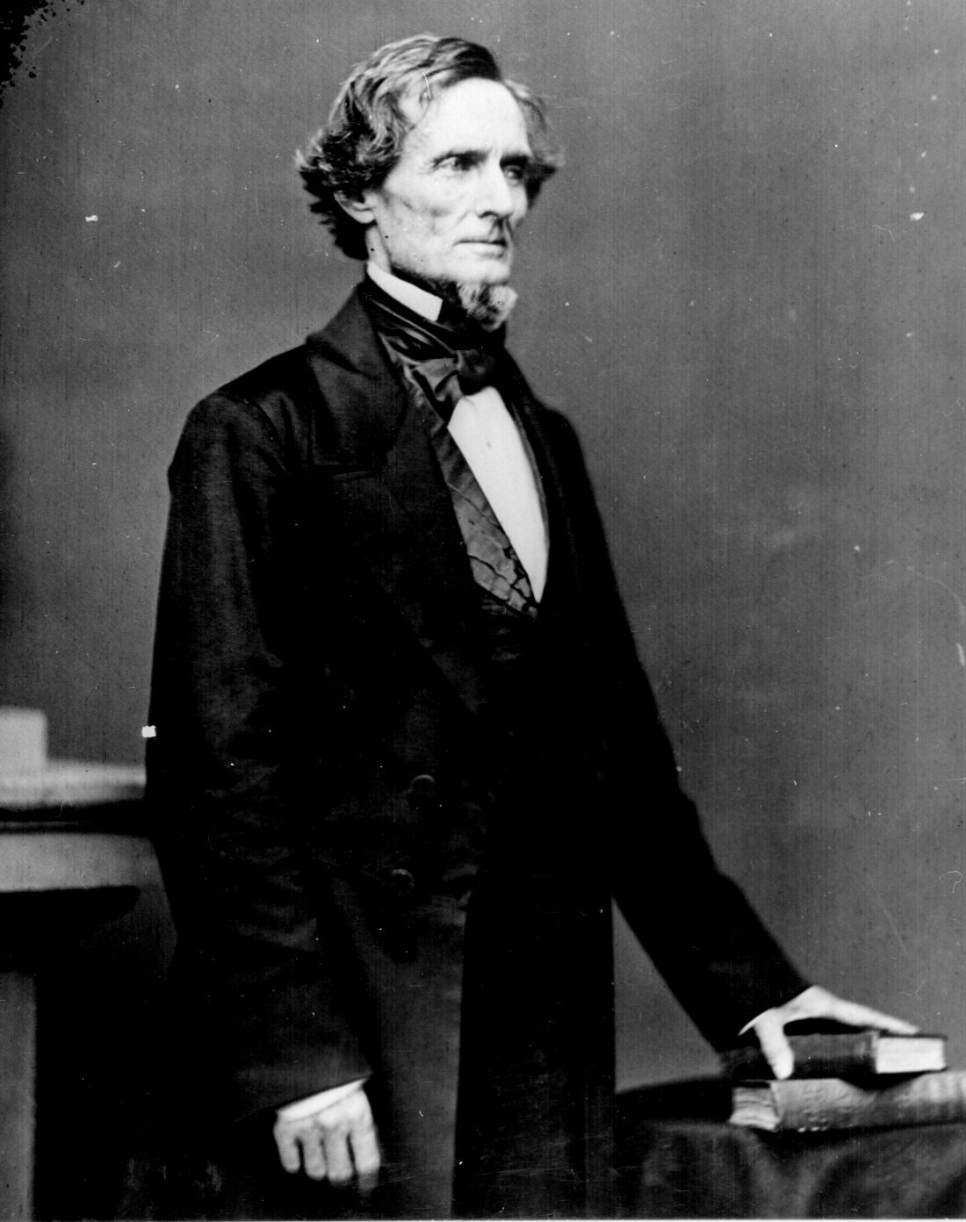
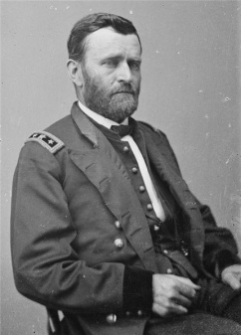
Name___________
What was Sherman’s March to the Sea?
____________________________________________________________________________________________________________________________________________________________________________________________________________
Which individual would have been the MOST supportive of Jim Crow laws?
A.) an African American
B.) a Southern politician
C.) Ulysses S. Grant
D.) Abraham Lincoln
Who was America’s baseball hero during the 1920’s?
A.) Hank Aaron
B.) Yogi Berra
C.) Roy Campanella
D.) Babe Ruth
What major event happened on September 11, 2001?
A.) Vietnam invaded the U.S.
B.) United States bombed Iraq
C.) terrorists attacked the United States
D.) the Persian Gulf War began
I was the overall commander of the Union army at the end of the Civil War. Who am I?
__________________
I was the President of the Confederate States of America. Who am I?
_______________

Slide 10
Name___________
What were cattle trails and why were they important?
_______________________________________________________________________________________________________________________________________
Which of the following made African Americans citizens?
A.) Thirteenth
Amendment
B.) Fourteenth
Amendment
C.) Underground
Railroad
D.) Compromise of
1877
Two brothers, Wilbur and Orville Wright, built the world’s first successful_______________.
Who was the overall commander of Confederate Army?
A.) Robert E. Lee
B.) Stonewall Jackson
C.) Jefferson Davis
D.) Abraham Lincoln
What was rationing? What was it trying to accomplish?
___________________________________________________________________________
_______________
Who was one of the most effective commanders in the Confederate Army? He became the right hand man to General Robert E. Lee. He died from injuries he received from friendly fire as he returned from scouting Union forces.
__________________________
Joseph Stalin was the leader of
A.) Germany
B.) Great Britain
C.) Italy
D.) France

Slide 11
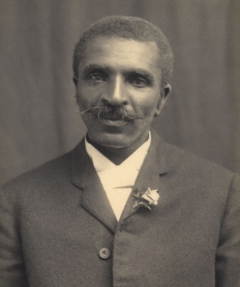
Name___________
Describe the life of an immigrant in the late 1800’s
__________________________________________________________________________________________________________________________________________________________________
I was one of the first African Americans to make great contributions to science. I developed the crop rotation method. Who am I?
________________________________
Louis Armstrong was a
A.) baseball hero
B.) jazz musician
C.) pilot
D.) poet
Explain what the Missouri Compromise and the Compromise of 1850 were both meant to do.
_______________________________________________________________________________________________________________________________________
Why did the United States enter World War I?
A.) The United States
wanted more land
B.) Mexico attacked
the U.S.
C.) German submarines
were attacking U.S.
ships
D.) The U.S. wanted
control of France
Which battle was the bloodiest of the Civil War and ended Lee’s final attempt to invade the North?
A.) Gettysburg
B.) First Bull Run
C.) Antietam
D.) Appomattox

Slide 12
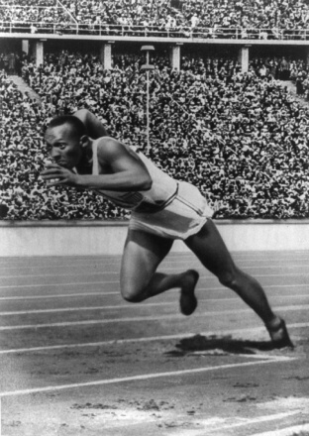
Name___________
Which of the following is the best example of someone participating in government?
A.) owning a business
B.) donating used goods
C.) becoming a school bus driver
D.) running for an elected
office
In Montgomery, Alabama, ______________refused to give her seat up on the bus.
Explain the main purpose for the amendment process. Why is it important to do it this way?
_________________________________________________________________________________________________________________________________________________________________________
What was the Lusitania and why was it important in U.S. history?
_______________________________________________________________________________________________________________________________________
____________________________________ wrote the book Gone with the Wind.
I was a great African American athlete. I won four gold medals and the 1936 Olympics. Who am I?
______________________________

Slide 13
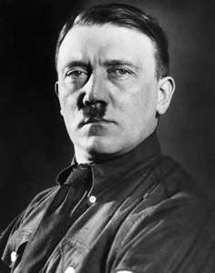
Name___________
People go into debt because
A.) they save all their money
B.) they cannot pay back
borrowed money
C.) their income increases
D.) they make a budget and
stick to it
During World War II, I was the leader of the Nazi party and preached hatred. Who am I?____________________________
Where is Pearl Harbor?
A.) Florida
B.) Hawaii
C.) Maine
D.) California
How was the Vietnam War different from other wars?
__________________________________________________________________________________________________________________________________________________________________________________________________________________________________________________________
What happened during the Cuban Missile Crisis?_________________________________________________________________________________________________________________________________________________________________________________________________
E pluribus unum stands for:
A.) too many chiefs
B.) out of many, one
C.) justice for all
D.) in God we trust

