Slide 1
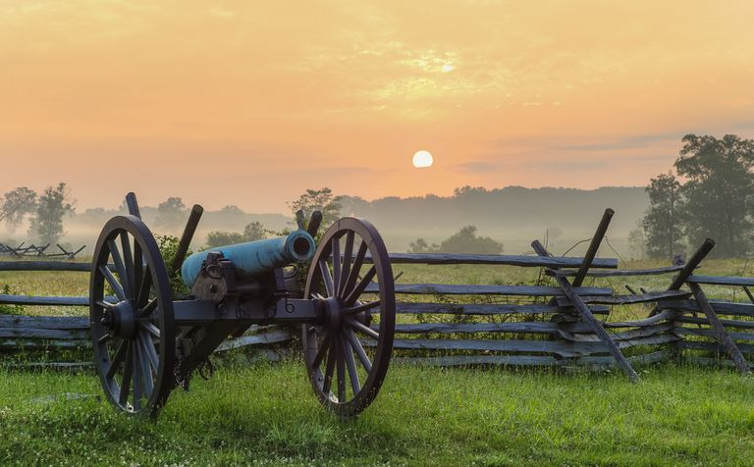
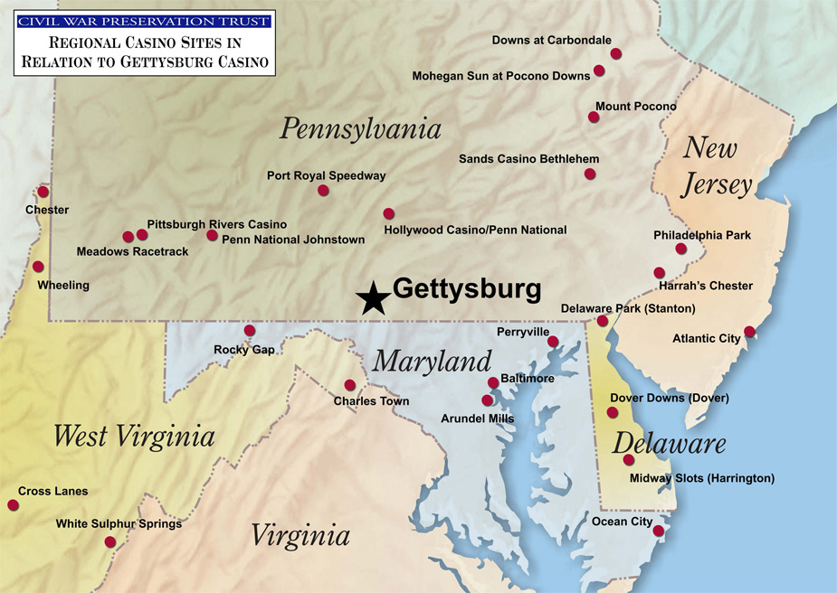
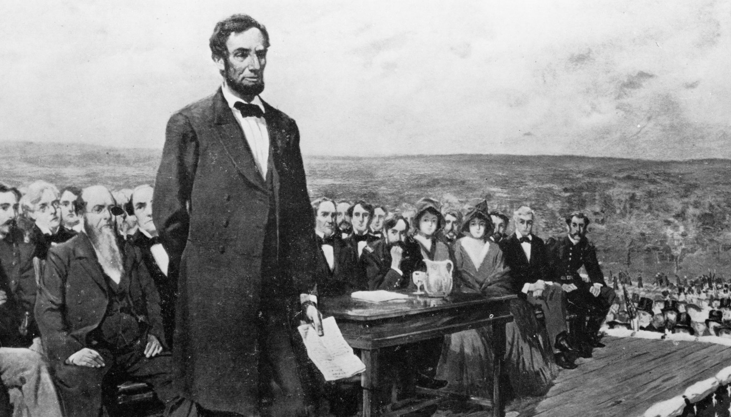
Gettysburg, PA
Gettysburg is best known for the 3 day Battle of Gettysburg ( July 1-4, 1863) during the Civil War. It is also the location of Abraham Lincoln’s famous “Gettysburg Address” where he dedicated a cemetery to the fallen soldiers of the battle.

Slide 2
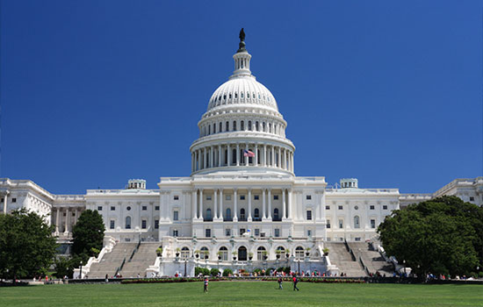
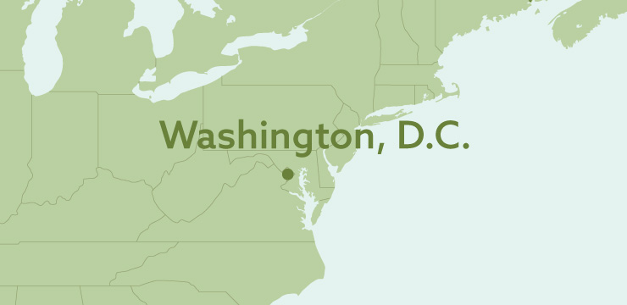
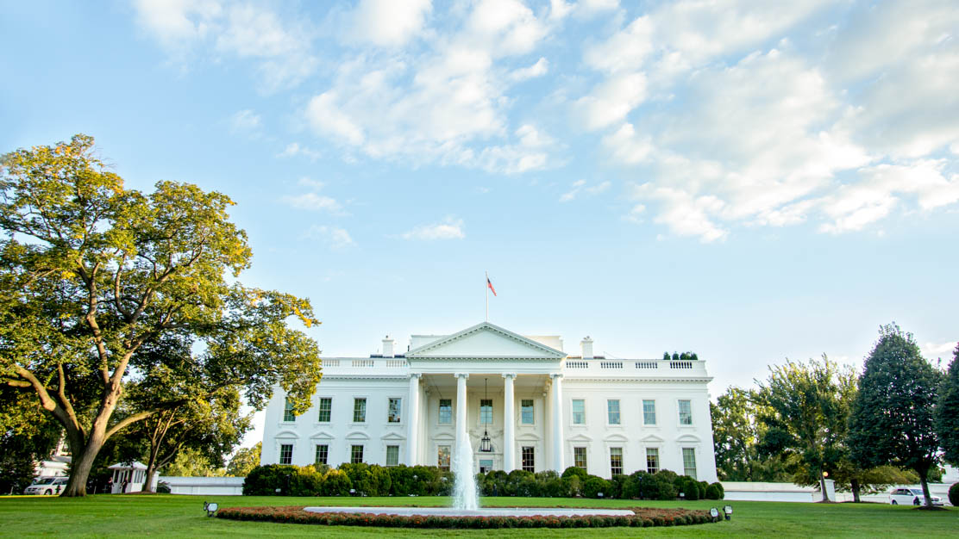
Washington, DC
Washington D.C. is the capital of the United States. It is unique because it is not within a state, rather it is a district ( District of Columbia). It is home to the federal government buildings including the Capitol, White House, and Supreme Court building.

Slide 3
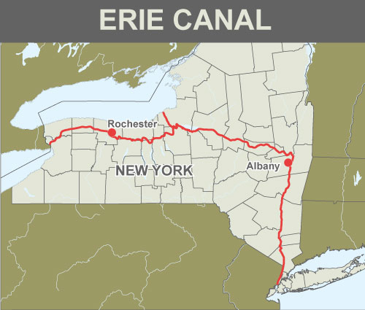
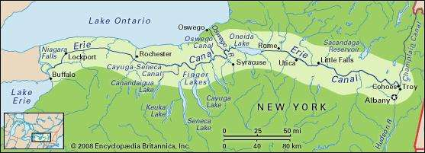
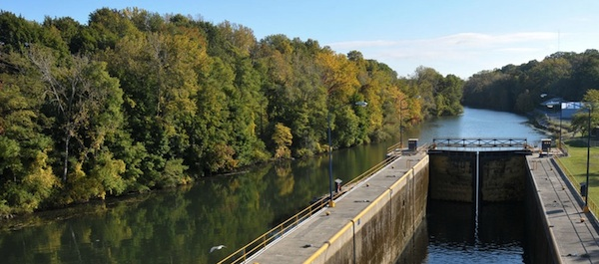
Erie Canal
The historic man made waterway connects Lake Erie (Great Lakes) with New York City allowing goods to be transported along the Great Lakes and further west. It also linked the Great Lakes with the Atlantic Ocean.

Slide 6
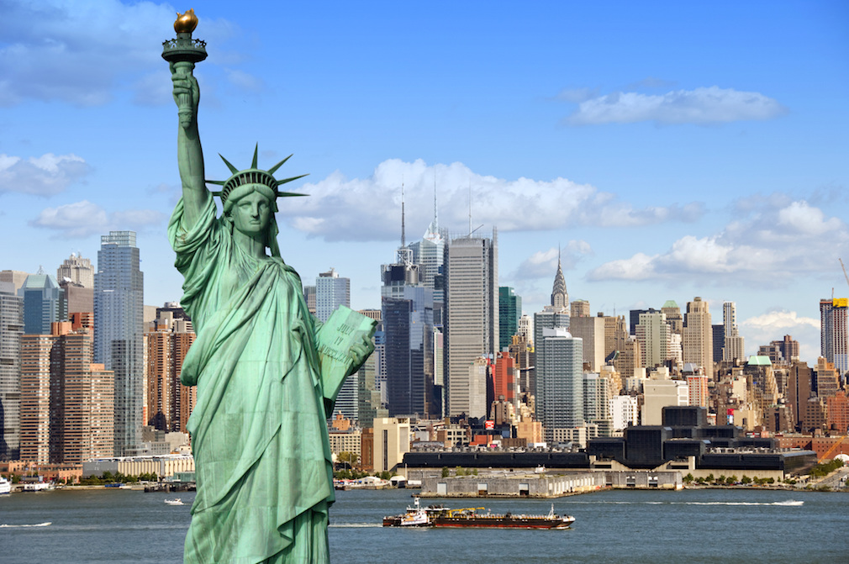
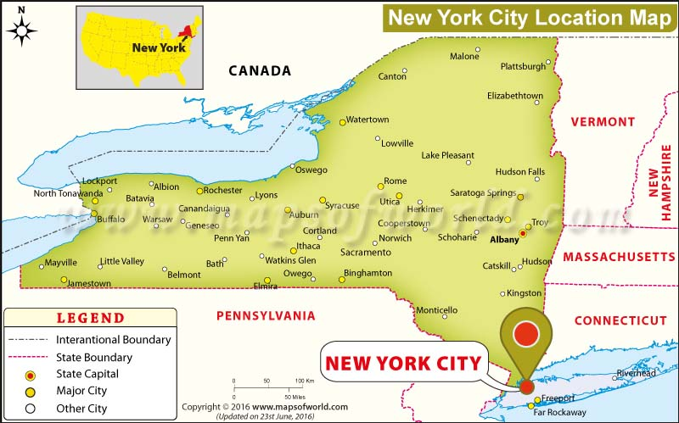
New York City, NY
New York City is the largest city ( by population) in the United States. It is comprised of 5 boroughs (sections) sitting where the Hudson River meets the Atlantic Ocean. Its iconic sites include skyscrapers such as the Empire State Building and sprawling Central Park. Broadway theater is staged in neon-lit Times Square.

